Slide 1


PRACTICE
Activity 2
GRAPHIC ELEMENTS
15 MIN
Sign in
Mail
Password
Create account
Sign in

Slide 2

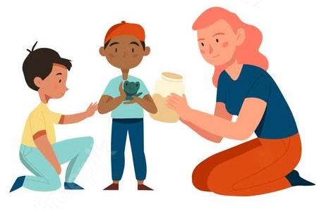
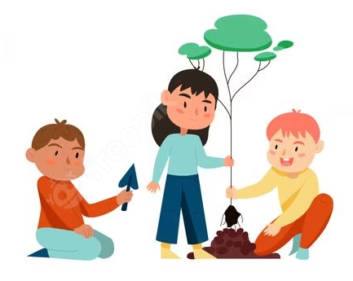


PRACTICE
Activity 2
15 MIN
Inclusive
learning
Each teachers or educators adopts an inclusive, learner-centered pedagogy:
Adopt posture of educator instead of lecturer
Be attentive to each student, listen, understand, encourage
Empower students responsibility in projects
Promote solidarity between peers to help students in difficulty
Promote respect and trust between peers and staff

Slide 3

PRACTICE
Activity 2
15 MIN
Course evaluation
Evaluation student at the end of this course, learn from mistakes to improve the future training
Students were able to investigative individually to find a solution
Students were able to analyze a situation and express a critical judgment
Students were able to create, innovate, fusing what they have learnt
Students were able to work and cooperate in team during the sessions
Students were able to communicate appropriately their solution
Example of evaluation transversal skills

Slide 4





PRACTICE
Activity 2
15 MIN
CERTIFICATE OF PARTICIPATION
CERTIFICATE OF PARTICIPATION
Presented to
SOPHON SEN PHEARUN CHHUN KHY PHAT
For their participation in eight hours of IT-related challenges during Passerelles numériques inaugural Halloween Cup on October 28, 2021.
Third Place in Coding Challenge
Ronan OGOR
IT Coordinator & Pedagogical advisor
of Passerelles numériques Cambodia
Jun Rey ANSING
Innovative Technology Coordinator
of Passerelles numériques Philippines
Lucas SINROD
IT & Training Manager
of Passerelles numériques Vietnam

